Slide 1
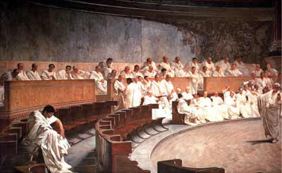
The Roman Republic

Slide 2
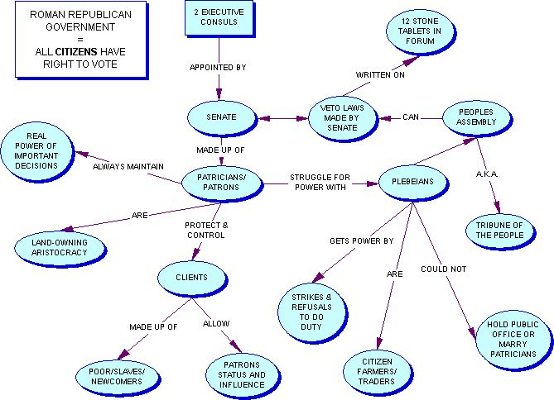
Republic Government: Aristocratic Monarchy w/ Democratic element
Monarchial elements: Two Consuls
Directed government, army
Acted as judges, chief priests
Aristorcratic: Senate
Controlled state budget
Could pass laws
Served for life
Democratic: People’s Assembly (“Assembly of Tribes”)
Approved / rejected laws
Decide on war
Acted as final court

Slide 3
Republic Government
Basis of power
Consul
possess imperium (right to rule)
Need for leadership
Senate
Members were richest men in Rome
People’s Assembly
Provided most of the soldiers
Limits on Power
Consuls: one year term, each could veto the other
Senate: no control of army, needed plebeian as soldiers
Assembly: could not
suggest laws, often paid
as clients by elite

Slide 4
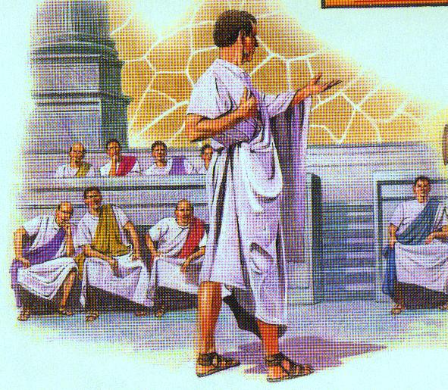
Republic’s Government
New Senate
300 senators appointed from patrician class
Hereditary position
Advised consuls
New popular assembly
Elected all office holders
All male citizens were members
Only patricians in the Assembly could hold office

Slide 5
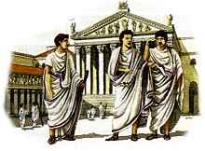
Problems of Republic: Social Class Tension
Patricians vs. plebeians – why? Three reasons…
#1: Money & Influence - Patricians
Lived in cities, where walls protected their property
Bought their way out of military service
Patrician status inherited
Held virtually all political power

Slide 6
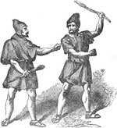
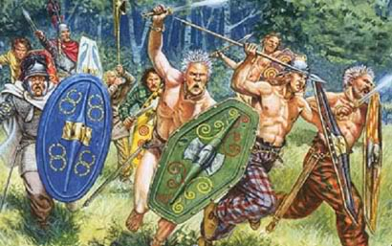
Problems: Class Tension
#1 – Money & Influence: Plebeians
Lived outside cities (farms)
When in army, lands neglected
During war, farms devastated by enemy, families driven away
Returned from war and had to borrow money from Patricians to restart farms

Slide 7
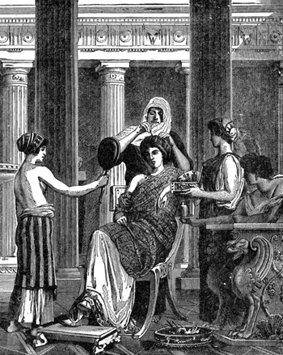
Problems: Class Tension
#2 – The Law of debt
If plebeians owned land, they generally needed to borrow money to start farm
If they couldn’t pay debt, they were arrested, made slave of creditor
Creditor usually a patrician
Effect: keep poor in poverty

Slide 8
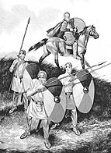
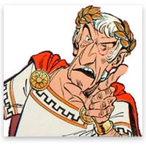
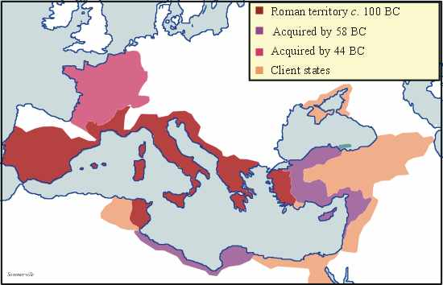
Problems: Class Tension
#3 – The Unequal Division of Land
All land acquired through war belonged to all people
BUT government was controlled by patricians
Used public lands for their own benefit
Allowed it to be used by other patricians for cheap / no rent
Patricians thought of public land as theirs!

Slide 9
Result of class tension? REVOLT!!!
In about 450 BC, Plebeians revolted, threatened to start their own city near Rome (& then return and conquer Rome!)
Patricians, seeing loss of their army and very likely conquest, made legal changes

Slide 10
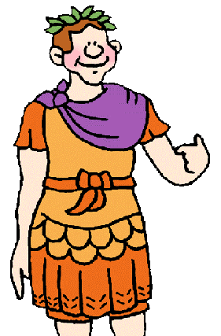
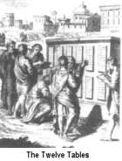
Table of Laws (450 BC)
Legal code adopted by Senate
Canceled all debts and release all debtors from slavery
Created new public office: Tribune
Two appointed from Plebeian class
Given power to veto (over-rule) any patrician office holder who acts unjustly
Tribunes could not be arrested
Put on bronze tablets near marketplace so all could read law

Slide 11
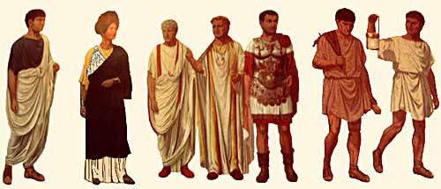
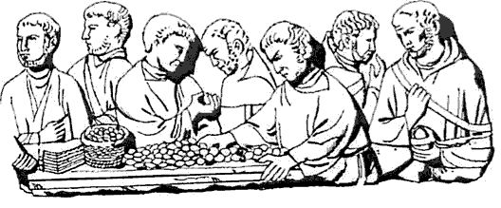
Roman Citizenship, post Table of Laws
Rights of citizens
Hold office (patricians)
Vote (plebes and patricians)
Social intermarriage allowed
Own property (all)
Enter into legal contracts (become merchant) (all)
Responsibilities of citizens
Service in army (mainly plebes)
Pay taxes (plebes, some patricians)

