Slide 1
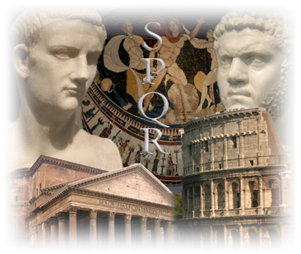
Outcome: Geography & Early Republic
Ancient Rome
& The Origin of Christianity

Slide 2
Constructive Response Question
Who were the earliest Romans and how did each contribute to the founding of Rome?
Compare and contrast the Roman Republic and the Roman Empire using specific examples:
What contributions did the Romans make to the cultural advancement of the world?

Slide 3
What will we learn?
Origin & Geography of Rome
The Earliest Romans (Latins, Greeks, & Etruscans)
Early Roman Culture (The Roman Republic)
The Punic Wars (Rome vs. Carthage)

Slide 4
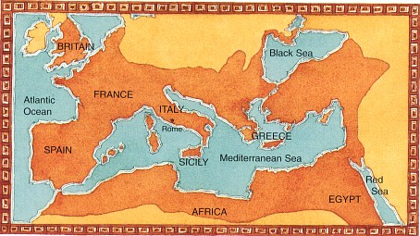
Geography & Early Republic
Setting the Stage
With the defeat of the Persians by Alexander and the eventual decline of the Greek Civilization, power would eventually shift west towards the Italian peninsula
The Romans would build an amazing empire filled with many different cultures and help spawn a brand new religion: Christianity

Slide 5
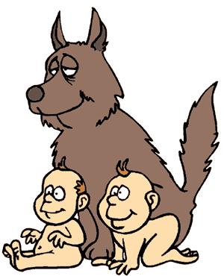
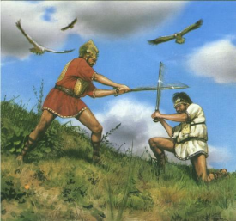
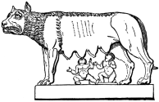
Geography & Early Republic
Origins of Rome
Legend says that twins Romulus and Remus were abandoned on the Tiber River and raised by a she-wolf
Later the two boys decided to build a city
Eventually Romulus kills Remus & city of Rome is named after Romulus

Slide 6
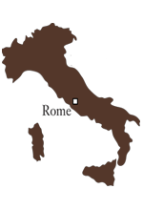
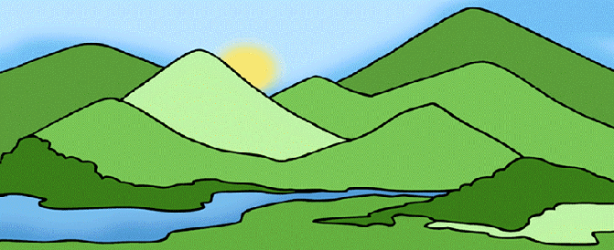
Geography & Early Republic
Geography
Rome was built on 7 rolling hills of Tiber River
Located on Italian Peninsula (Italy)
Bordered by Adriatic Sea to the east
Near midpoint of Mediterranean Sea
Mediterranean Climate: warm year round- encouraged outdoor activities

Slide 7
Geography & Early Republic
The First Romans
Three groups settled on Italian Peninsula from 1000-500 B.C.
The Latins
Built original settlement of wooden huts
Considered to be the first Romans
Helped spread Latin derived languages to the area

Slide 8
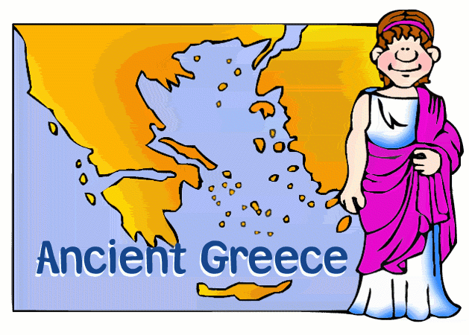
Geography & Early Republic
The Greeks
Moved north into Italy during decline of Hellenistic Culture
Settled in Southern Italy and Sicily
Brought all of Italy, including Rome, into contact with the Greek civilization
Brought architecture, democracy, and philosophy

Slide 9
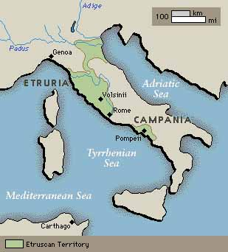
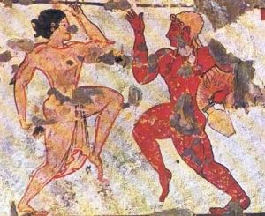
Geography & Early Republic
The Etruscans
Skilled metal workers native to northern Italy
Strongly influenced Roman civilization
Influenced Roman arch
Influenced Roman lust for killing (ex. Gladiator battles)

Slide 10
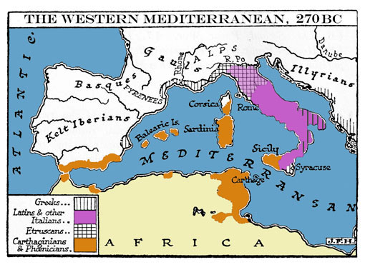

Slide 11
Geography & Early Republic
Early Rome
Early Etruscan kings and successors built temples and public centers in Rome
The Forum was the heart of the Roman political life
After Rome’s last king was driven from power in 509 B.C for being too harsh, the Romans declared they would never again be ruled by a king
Instead they established a republic, which meant “public affairs”
A republic is a form of government in which power rests with citizens who have the right to vote for their leaders
In Rome, citizenship with voting rights was granted only to free-born male citizens

Slide 12
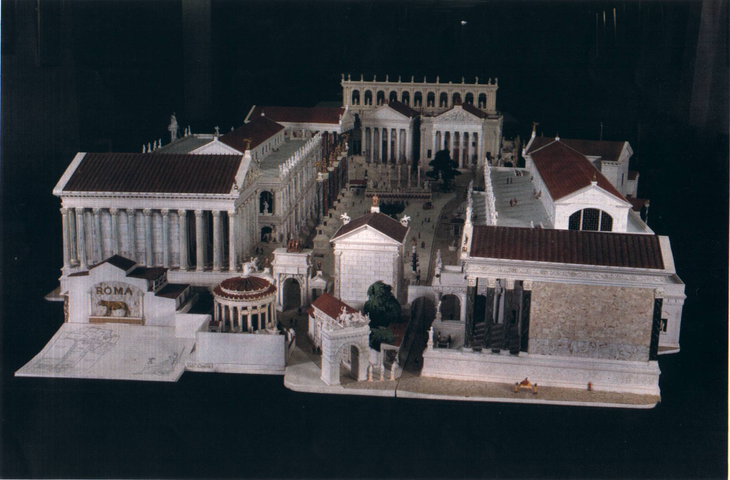
The Roman Forum

Slide 13
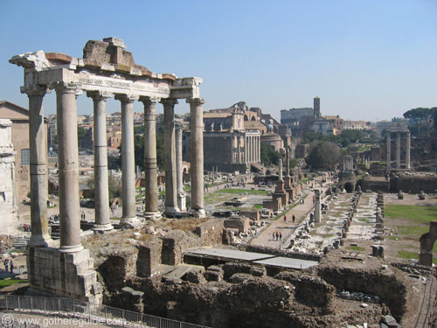
Roman Forum Ruins

Slide 14
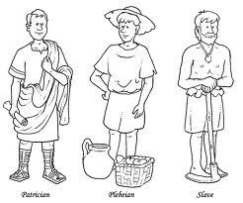
Geography & Early Republic
People of Rome
Rome was divided up into several different groups who struggled for power
Patricians: wealthy landowners who held most of the power
Plebeians: the common farmers, artisans, and merchants; majority of pop.

Slide 15
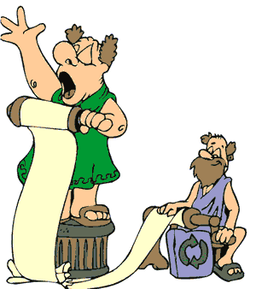
Geography & Early Republic
Tribunes: elected representatives who protected the rights of the plebeians from patrician officials

Slide 16
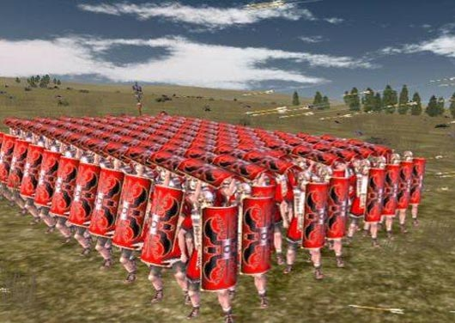
Geography & Early Republic
Consuls: two officials with limited power and one year terms; one controlled the army the other directed the government
Dictator: in times of crisis, the republic could appoint a leader with absolute power to make laws and control the army; power lasted for 6 months
Legions: military units made up of 5,000 soldiers

Slide 17
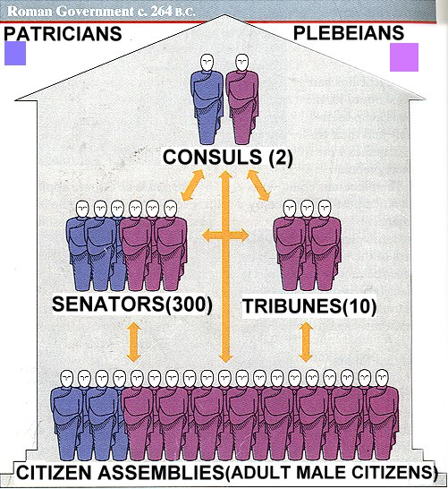

Slide 18
Geography & Early Republic
Roman Power Expands
Steadily the Romans conquered the Italian Peninsula
As Rome conquered lands, people were absorbed into their ever growing territory
Some people were accepted as citizens, others simply became allies
Rome went to war against Carthage; a powerful city in North Africa
The struggle became known as the Punic Wars (264-146 B.C.)

Slide 19
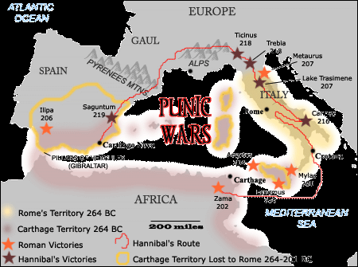
The Punic Wars

Slide 20
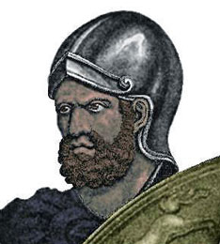
Geography & Early Republic
Carthage was led by a brilliant general named Hannibal
Hannibal assembled an army of 50,000 infantry, 9,000 cavalry, and 60 elephants intent on capturing Rome
He led his troops up through Spain and crossed the Alps into Italy

Slide 21
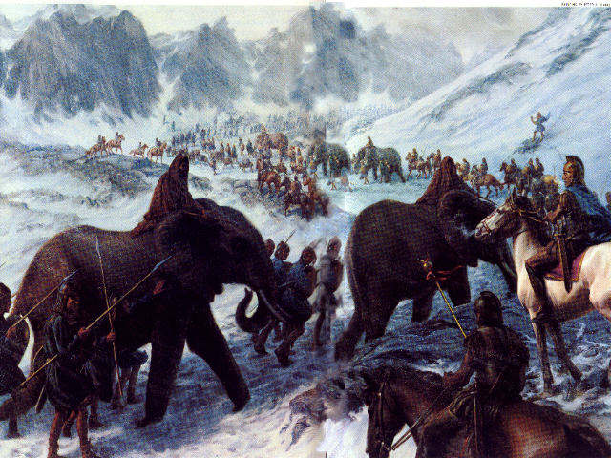
Hannibal Crossing the Alps

Slide 22
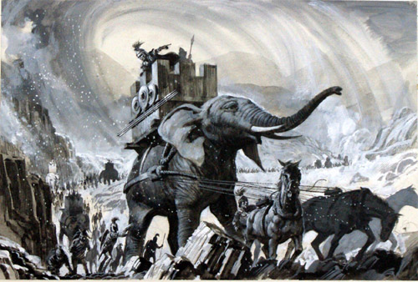

Slide 23
Geography & Early Republic
The Romans regrouped and prevented Hannibal from sacking Rome
Rome defeated Hannibal in 202 B.C. near Zama
Rome eventually defeated Carthage in the third Punic War extending its power across the Mediterranean Sea

Slide 24
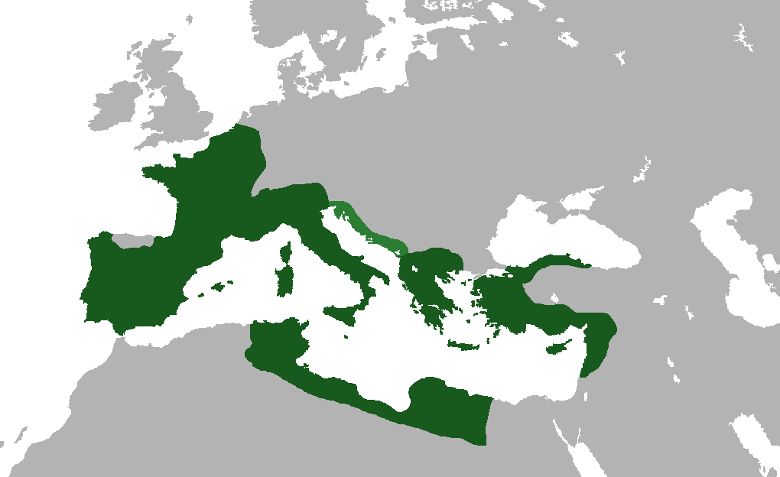
Geography & Early Republic
Rome’s territory and power would only get bigger and stronger…

Slide 25
Constructive Response Question
Who were the earliest Romans and how did each contribute to the founding of Rome?
Compare and contrast the Roman Republic and the Roman Empire using specific examples:
What contributions did the Romans make to the cultural advancement of the world?

